Slide 1
UK Traffic Accidents Analysis
DATS 6202 Machine Learning I
Final Project – Group 1
Mengjie Zhang, Xinning Wang, Yilin Wang

Slide 2
Introduction
Background:
Increasingly automobile traffic volume
Annual average daily traffic (AADT): the total volume of vehicle traffic of a road for one year, or by date.
Our goal:
Predicting the severity of accident based on AADT data.

Slide 3
Dataset
Two dataset were all from Kaggle:
1.6 million UK traffic accidents:
400,000 observations
Over 30 features (location, accident severity, weather conditions and date, etc.)
https://www.kaggle.com/yesterdog/eda-of-1-6-mil-traffic-accidents-in-london/data
Predicting car count:
10,000 observations
Over 25 variables
https://www.kaggle.com/coolcoder001/predicting-car-count/data

Slide 4
Dataset
Target:
label ( Accident Severity): binary
Predictors:
Day of Week, Road Type, Speed limit, Pedestrian Crossing Human Control, Pedestrian Crossing Physical Facilities, Light Conditions, Weather Conditions, Road Surface Conditions, Special Conditions at Site, Carriageway Hazards, Urban or Rural Area, Did Police Officer Attend Scene of Accident, Hour, Peak

Slide 5
methods
Using Python to conduct:
Data preprocessing
Machine learning Network:
Random Forest
Neural Network
Naïve Bayes
Support Vector Machine (SVM)

Slide 6
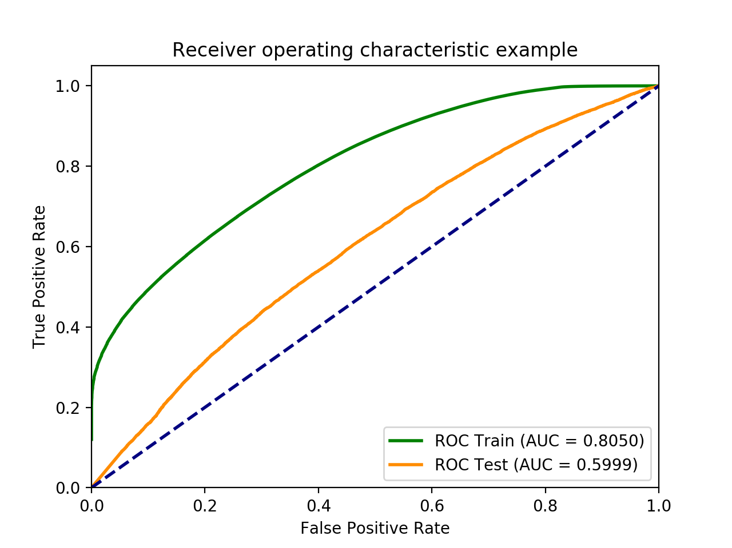
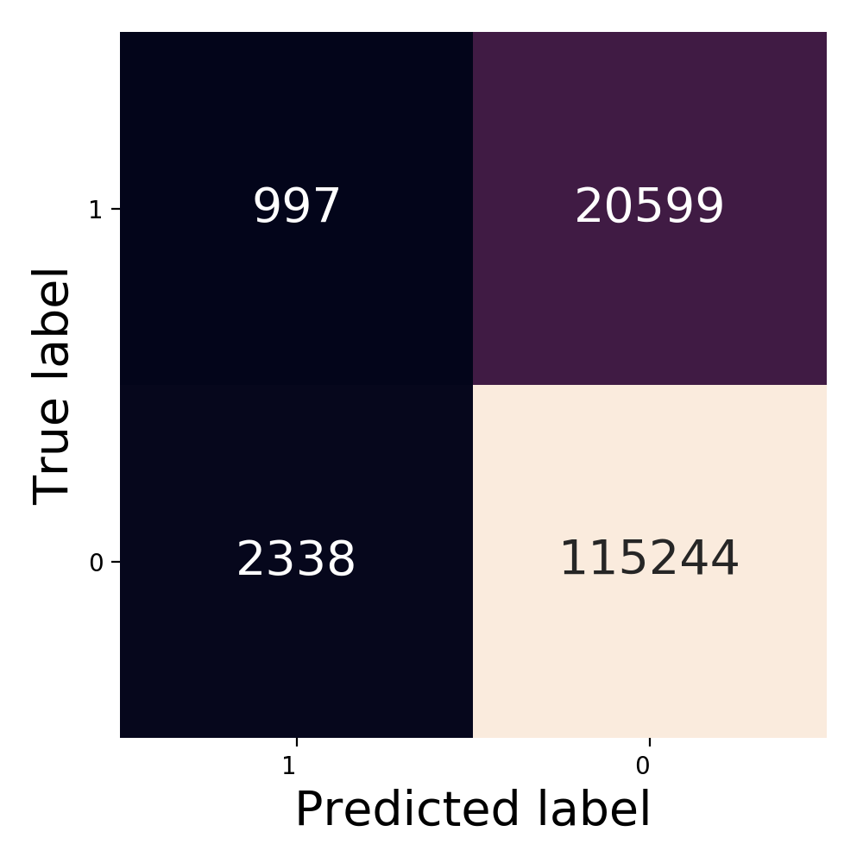
Results & Analysis
Random Forest
Notes:
This is the model we found using Grid-Search that achieved the best testing AUC. The AUC is 0.60, while the accuracy is 84%. The
accuracy inflated because of the imbalance in our dataset. Judging from the ROC curve, we can see that the model performs better on the positive side compared to the negative side, it’s because we have more positive data.

Slide 7
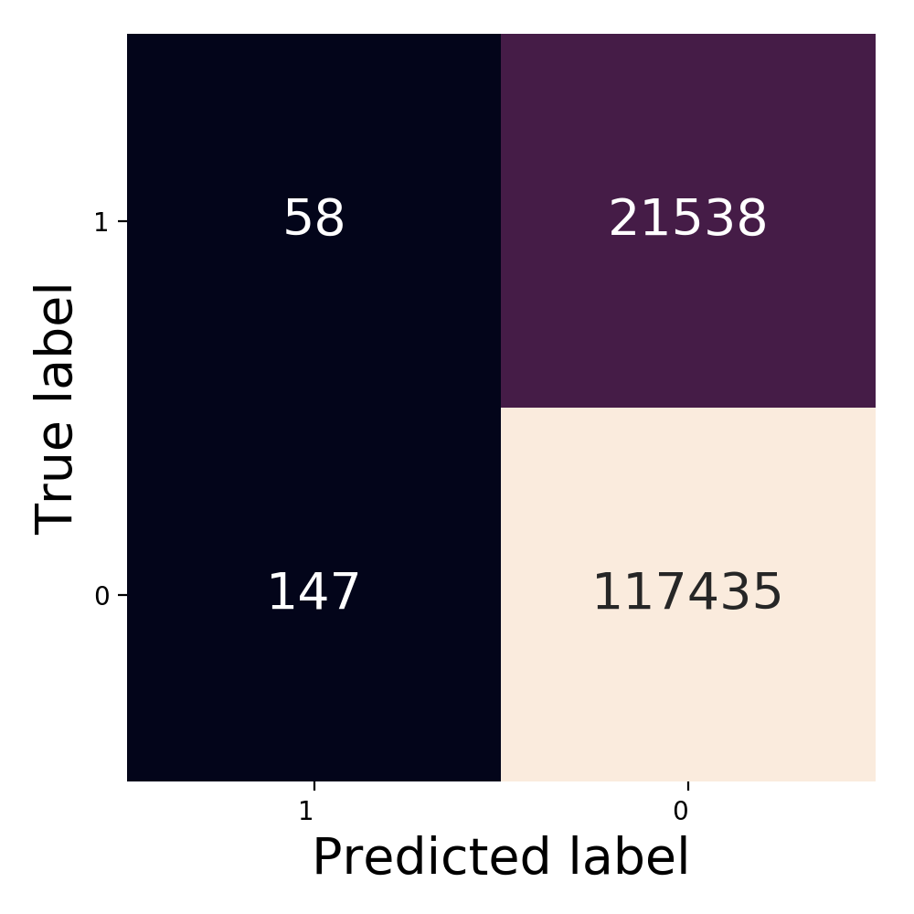
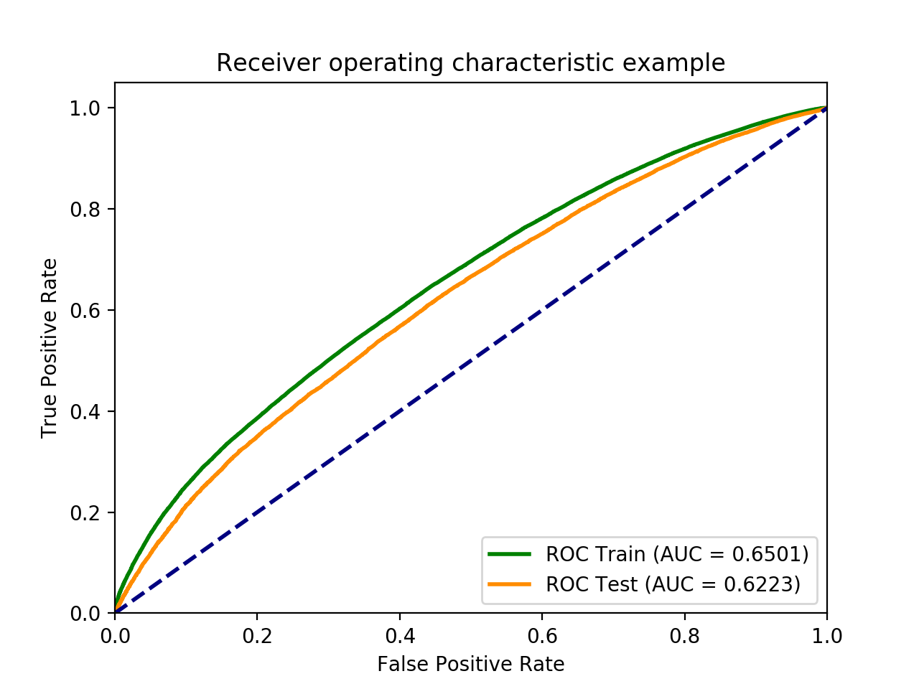
Results & Analysis
Neural Network

Slide 8
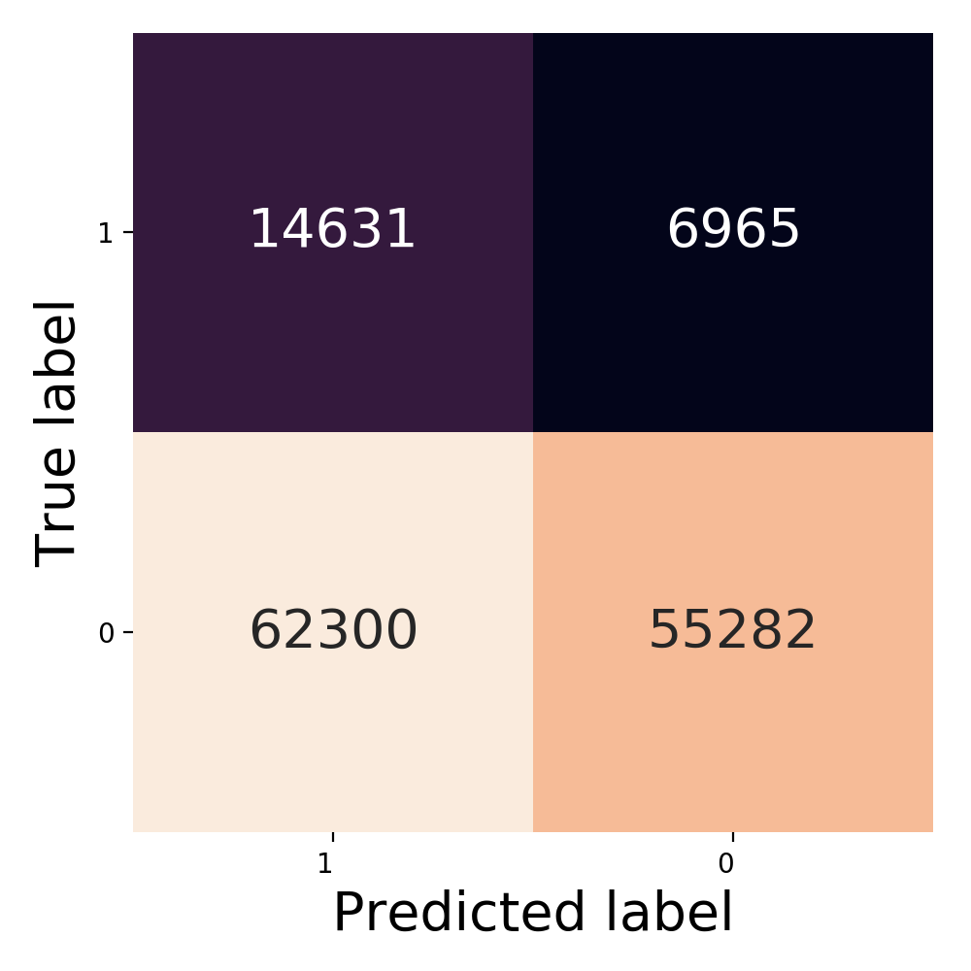
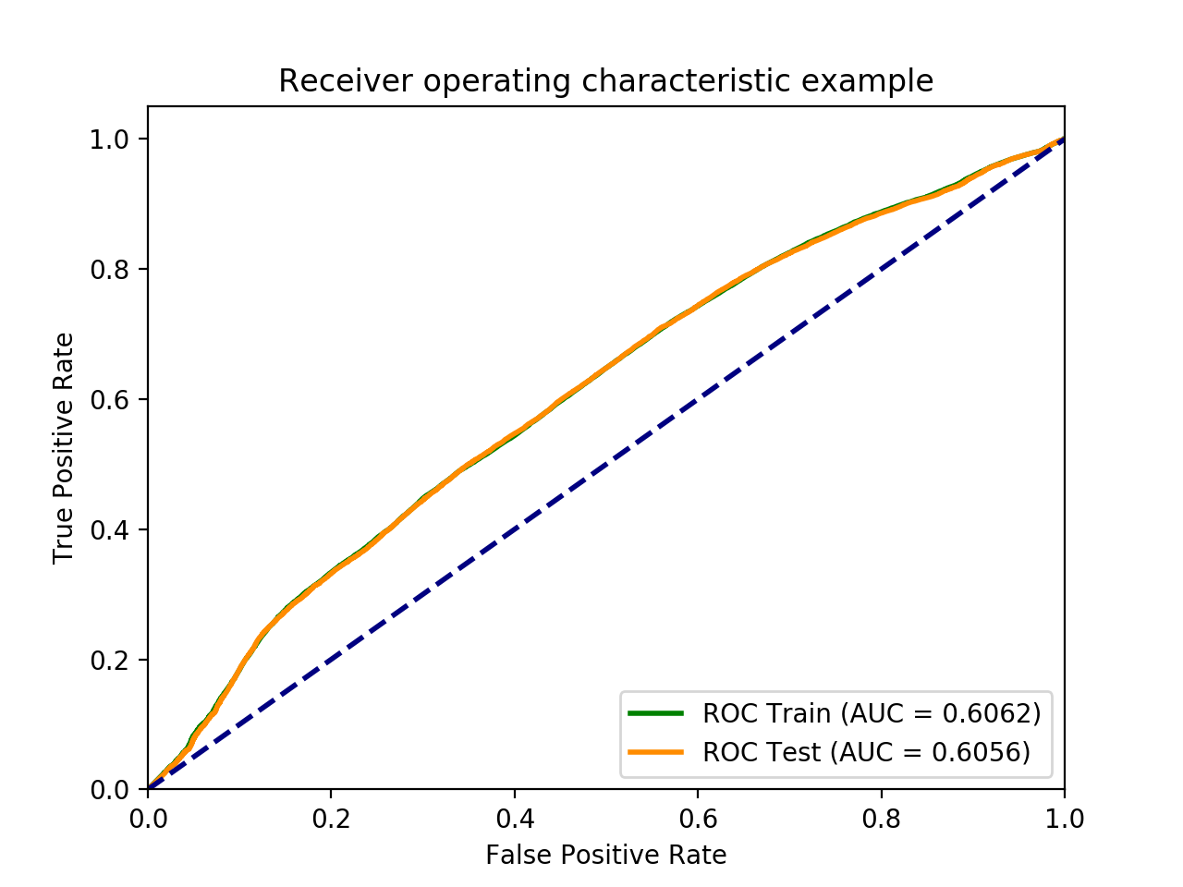
Results & Analysis
Naïve Bayes
Notes:
The AUC and model accuracy for test set are 0.61 and 0.51 respectively. The precision is
0.78, while recall is only 0.51. The classification report shows that class 1 shows higher precision (0.89) than class 0 (0.19) but lower recall.

Slide 9
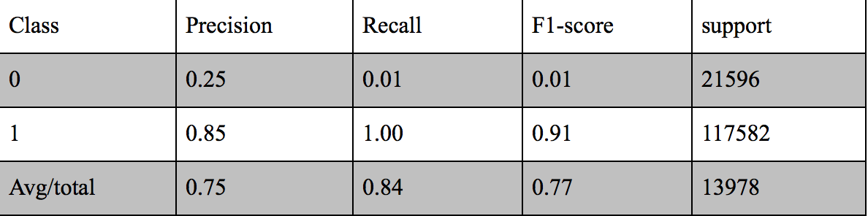
Results & Analysis
SVM
The classification report for linear SVC

Slide 10
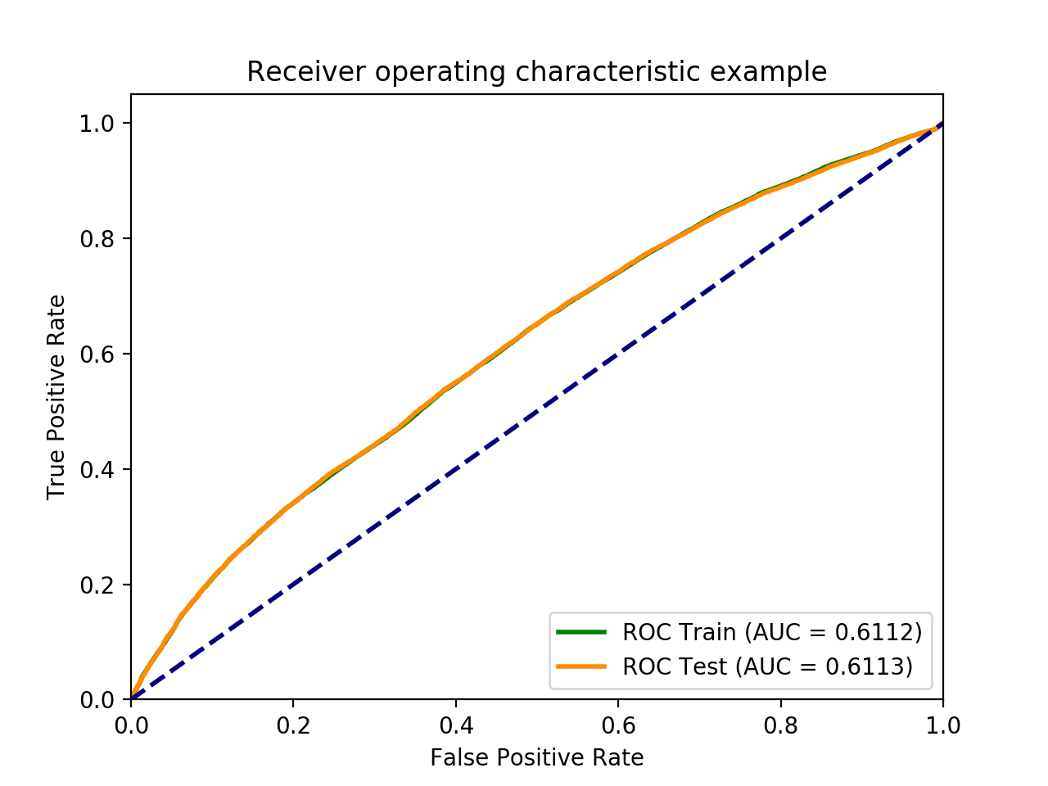
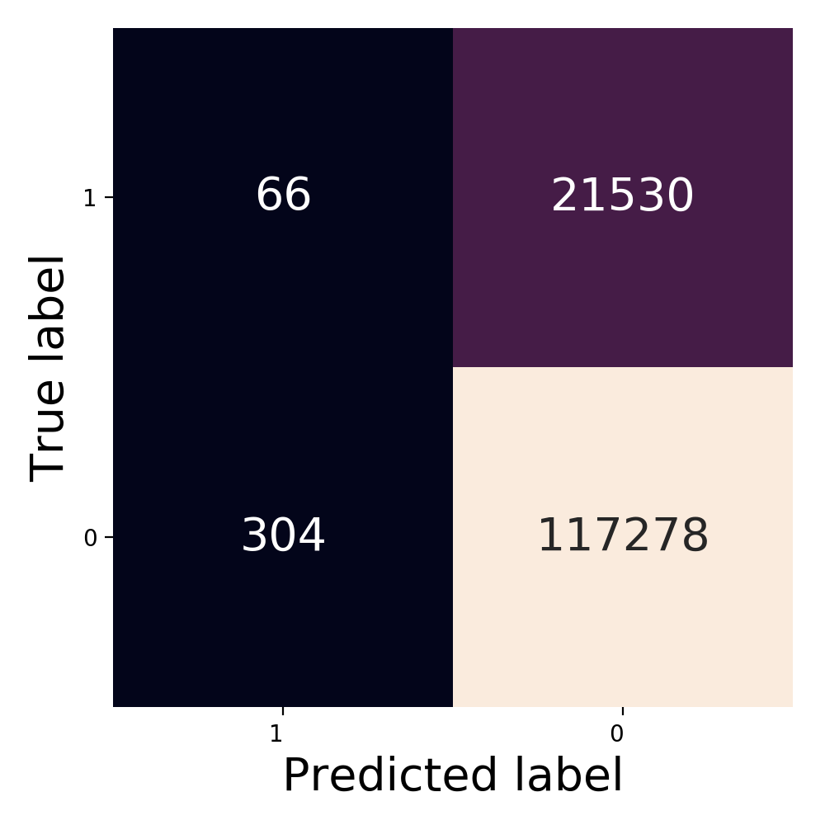
Results & Analysis
SVM
Notes:
The AUC and model accuracy for test set are 0.61 and 0.84, respectively. The linear SVC has better performance than Naive Bayes, considering its high precision and recall (0.75 and 0.84 respectively). The classification report shows that precision and recall both are very low for class 0 (0.25 and 0.01 respectively), although they are very high for class 1 (0.85 and 1).

Slide 11
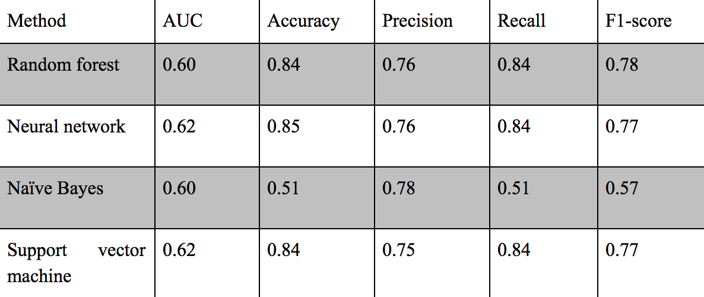
SUMMARY & conclusion
Performance metrics for all machine learning methods
Notes:
For the accident dataset, random forest, neural network (MLP), and support vector machine (linear SVC) shows better performance than Naive Bayes, although future work is needed to improve the AUC and sensitivity of class 0 (nonsevere accidents).

Slide 12
reference
Hoang Nguyen , Chen Cai, Fang Chen(2017). Automatic classification of traffic incidents’ severity using machine learning approaches. IET Intell. Transp. Syst., Vol. 11 Iss. 10, pp. 615-623.
UK Department of transport https://www.dft.gov.uk/traffic-counts/index.php
Kaggle https://www.kaggle.com/daveianhickey/2000-16-traffic-flow-england-scotland-wales
Neural Network Design (2nd Ed), by Martin T Hagan

Slide 13
THE END
Thanks!

